Slide 1
Automated Garage DOOR

Slide 2
PROJECT SUMMARY
OBJECTIVES
COMPONETS & MATERIALS
SYSTEM DESIGN METHODOLOGY
SOURCE CODE
EXPECTED RESULTS
PROJECT SIGNIFICANCE
CONCLUSION

Slide 3
INTRODUCTION
This project implements an Arduino-based automated garage system that utilizes an ultrasonic sensor to detect a vehicle’s presence, a servo motor to open/close the garage door, and an LED for automated lighting control. The system provides convenience, reduces manual effort, and ensures efficient use of electrical energy by activating lights only when required.

Slide 4
OBJECTIVES
Develop a functional prototype of an automated garage system using Arduino UNO.
Integrate ultrasonic sensing for vehicle proximity detection.
Use a servo motor for garage door automation.
Control garage lighting automatically based on the door’s state.

Slide 5
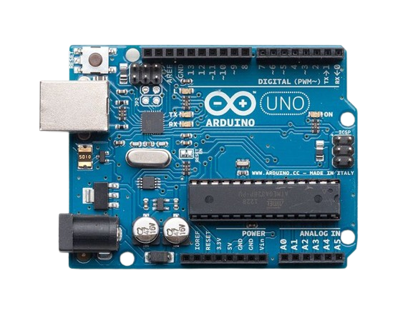
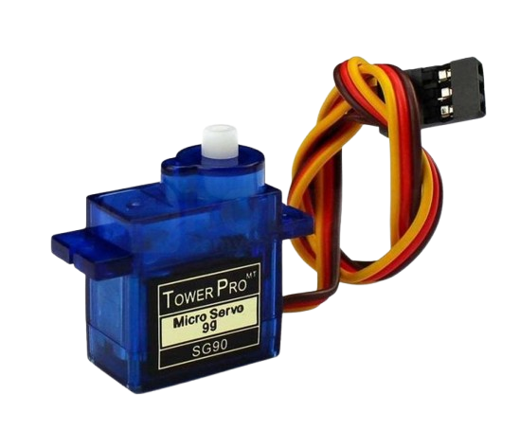
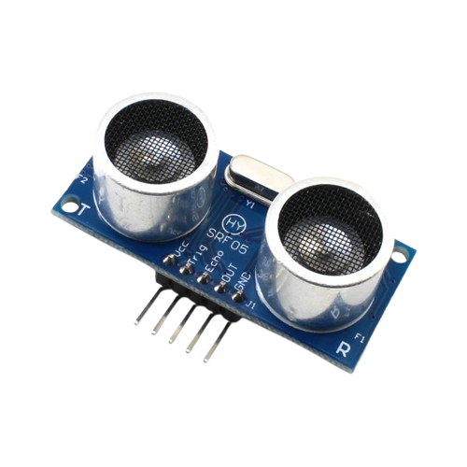
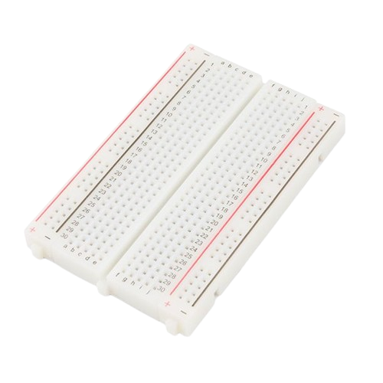
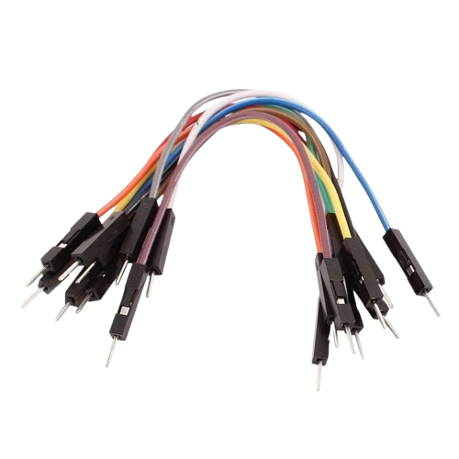
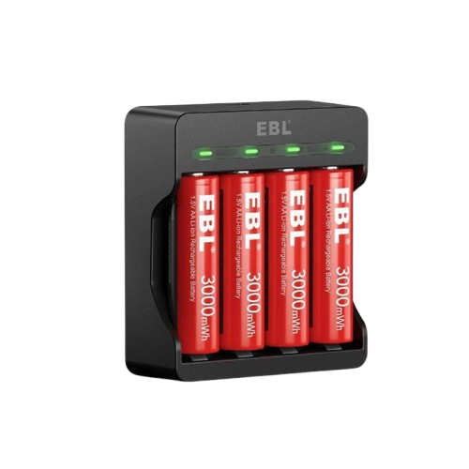
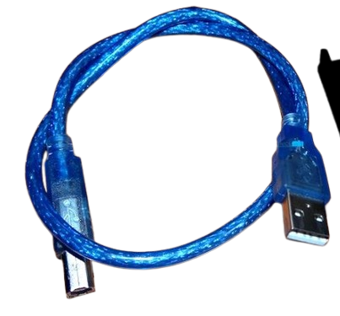
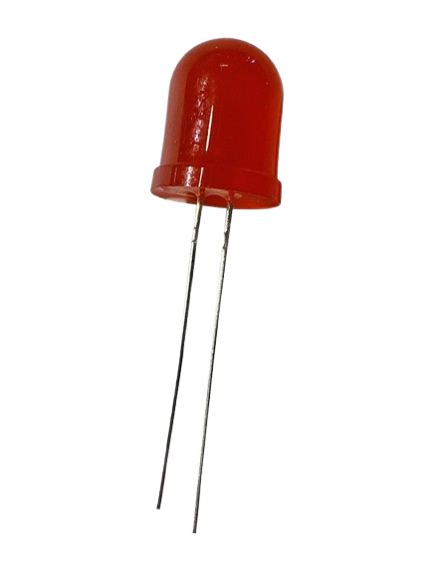
COMPONENTS & MATERIALS
Arduini Uno Board
Breadboard
Servo Motor
Ultrasonic Sensor
6X AA Battery Pack
LED
USB Power Cable
Jumper Wires

Slide 6
SYSTEM DESIGN & METHODOLOGY
1. Vehicle Detection:
The ultrasonic sensor measures the distance to approaching objects. If a vehicle is detected within 5 cm – 20 cm, the door-opening sequence is triggered.
2. Door Operation:
A servo motor rotates from 0° (closed) to 100° (open) when the vehicle is in range. After a 6-second delay, the door automatically returns to the closed position (0°).

Slide 7
SYSTEM DESIGN & METHODOLOGY
3, Lighting Control:
The LED turns ON when the garage door opens and OFF automatically when the door closes.

Slide 8
SYSTEM DESIGN & METHODOLOGY
4. Programming Logic:
The system was programmed in Arduino C++ using the Arduino IDE. The workflow is:
1. Trigger ultrasonic sensor → Measure distance.
2. Convert echo time into centimeters (cm) and meters (m).
3. If within range (5–20 cm):
- Open door (servo rotates to 100°).
- Turn ON LED.
- Wait 6 seconds.
- Close door (servo back to 0°).
- Turn OFF LED.
4. Otherwise, system remains idle.

Slide 9
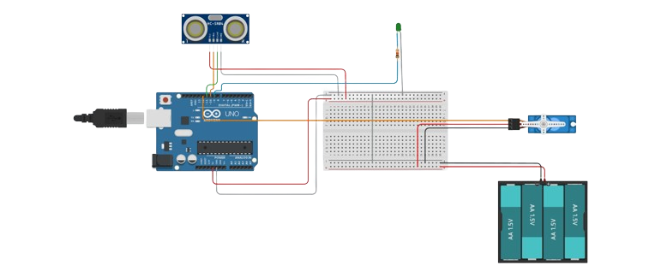
PROJECT SHEMATIC AND LAYOUT

Slide 10
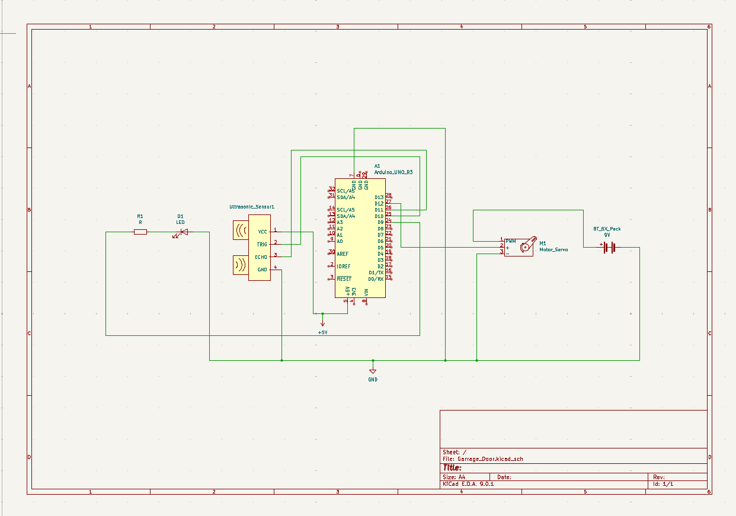
PROJECT SHEMATIC AND LAYOUT

Slide 11
EXPECTED RESULTS
Garage door opens automatically when a vehicle approaches within 5–20 cm.
LED turns ON while the door is open and OFF when closed.
Distance readings are displayed on the Serial Monitor in cm and m.

Slide 12
PROJECT SIGNIFICANCE
Convenience: Hands-free garage access for vehicles.
Energy Efficiency: Lights operate only when the garage is in use.
Scalability: Can be integrated into broader smart home automation systems.

Slide 13
Future Works
The sensor should be able to trigger (open the door) when in range and trigger to close when out of range
The servo motor movement is not still smooth enough

Slide 14
CONCLUSION
The Smart Garage Door and Lighting Control System successfully demonstrates how low-cost, Arduino-based automation can enhance convenience and efficiency in everyday life. The integration of ultrasonic sensors, servo motors, and LEDs provides a reliable and scalable prototype suitable for real-world smart home applications.

Slide 15
Thank You

